Slide 1

Bus Reservation System
Reserve ur ride.com
Group 5 Team:
Nishi Jain
Anurag Singh
Mithilesh Joshi
Sanjana Minocha
Rasee Ranjan
Charu Yadav
Chaitanya Joshi
Ateev Agarwal

Slide 2
Introduction
Bus Reservation System helps you find bus routes and tours with ease.
The system allows you to plan, schedule and manage unlimited routes with start and end destinations, show bus schedules with the departure times of all buses of a specific route, seat details.
Add various bus types, show seats number and a seat map.
Add multiple bus routes with boarding and arrival points.
View seats details with passenger details.

Slide 3
Problem Statement
Existing system is totally on book and thus a great amount of manual work has to be done. The amount of manual work increases exponentially with increase in services.
In existing system, there are various problems like keeping records of items, seats available, prices of per/seat and fixing bill generation on each bill.
Finding out details regarding any information is very difficult, as the user has to go through all the books manually.
Major problem was lack of security.
The proposed system is very simple in design and to implement. It has got following features:
Records are efficiently maintained by DBMS which provides security for the information.
Availability of seats can be enquired very easily.
Passengers can also cancel their tickets easily.

Slide 4
Features
Allows to choose date of Travel, Source and Destination.
Filters the buses on the basis of travel date, category of the bus, arrival time and boarding time.
Helps to choose boarding and arrival point.
Keeps the track of record about user’s travel details.

Slide 5
Technologies Used
Hibernate
Spring MVC
JavaScript
Angular JS
Oracle Database

Slide 6
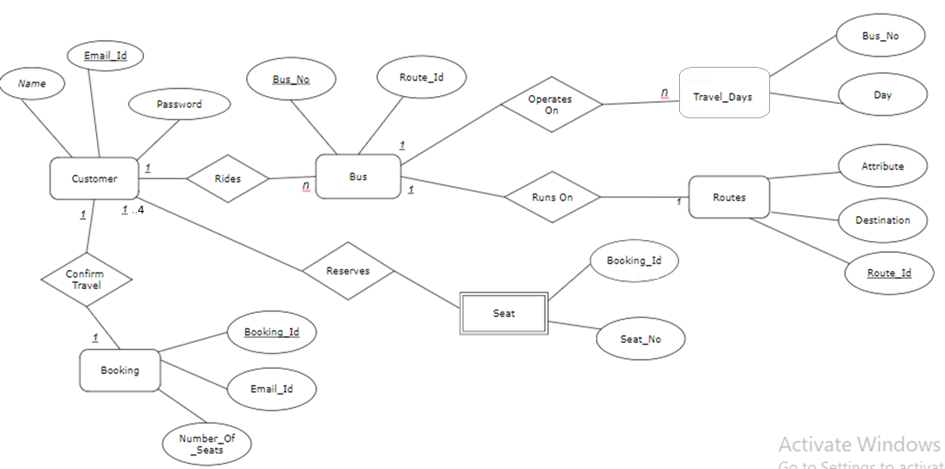
ER Diagram

Slide 7
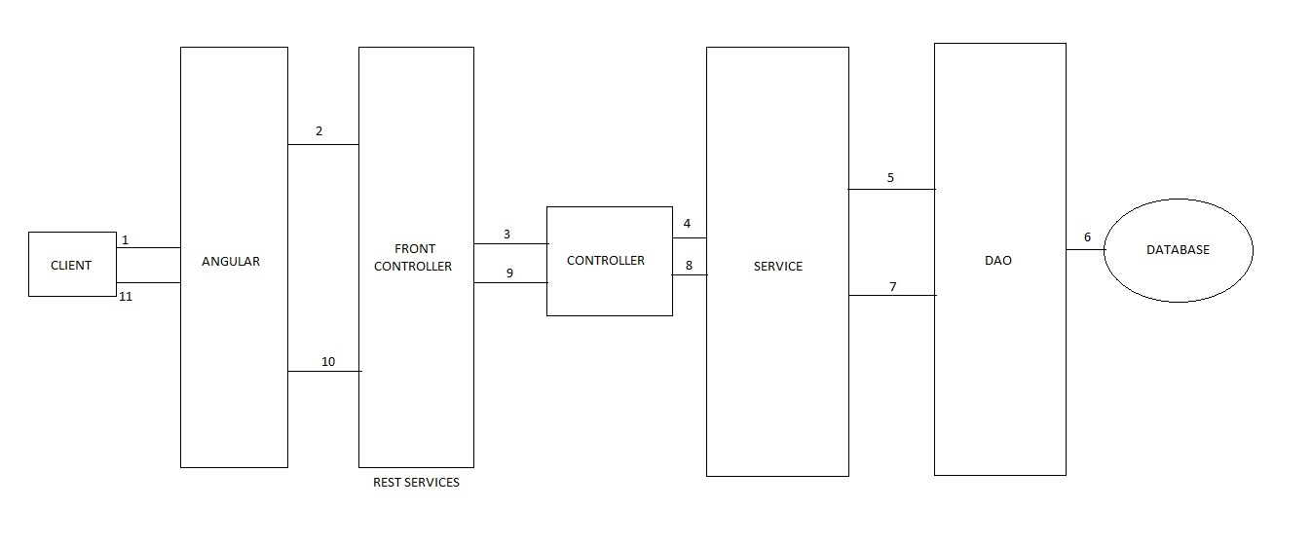
Web Architecture

Slide 8
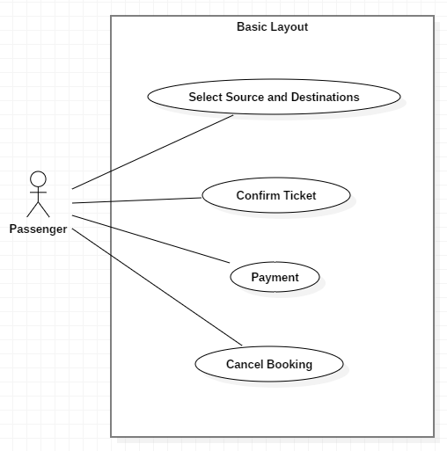
UML Diagrams
Use Case:

Slide 9
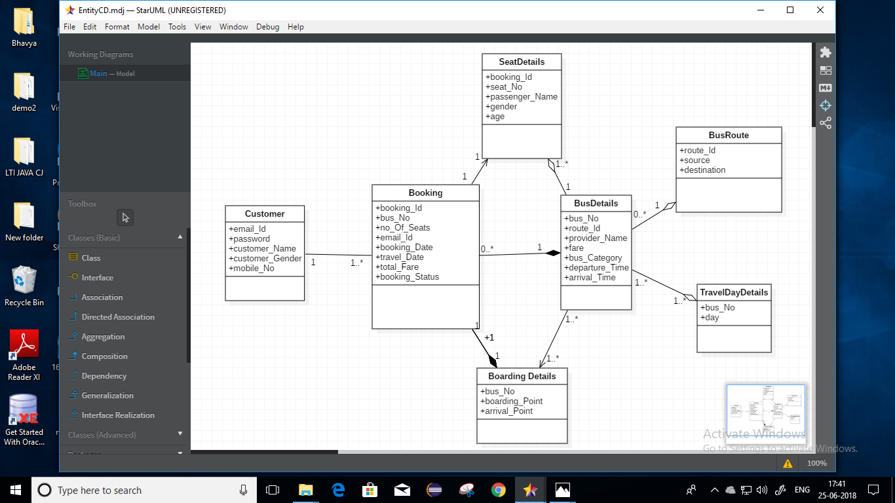
Continue…
Class Diagram(Entity):

Slide 10
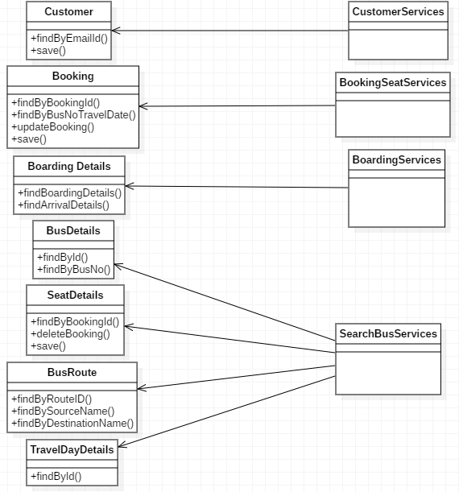
Continue…
Class Diagram(DAO):

Slide 11
Enter passenger details
Continue…
Select source, destination and traveling date
Book and Confirm Tickets
Activity Diagram:
Select Bus
Payment
LogIn/Sign up
Successful
No
Successful
No
Print and View ticket
Yes
Select seat
No
Successful
Yes

Slide 12
Future Scope
Inclusion of payment gateway.
Cancellation of the ticket whenever desired.
Facility of tracking the bus.

Slide 13
Conclusion
In the present era due to huge amount of data, handling them manually is not feasible and the same is true for bus reservation facility.
Managing this data through online system provides ease not only to the customers but also to the bus providers.
Using this system assures data consistency of all the users which is a major drawback of manual system.
In future after the amalgamation of tracking facility, security of the travelers will also increase by many folds

Slide 14
Thank You

